Slide 1
Welcome to Himilcon’s lab for EDUC 275B (Data II)!
Lab 5
Wednesday, February 21, 2024
Himilcon Inciarte
himilcon_Inciarte@berkeley.edu

Slide 2
Upcoming Assignments
Quiz 2:
02/25/2024
Homework 3 & 4:
02/26/2024
Project 1:
03/22/2024

Slide 3
Quiz 2

Slide 4
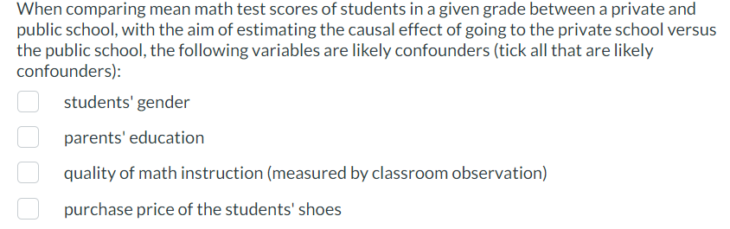

Slide 5
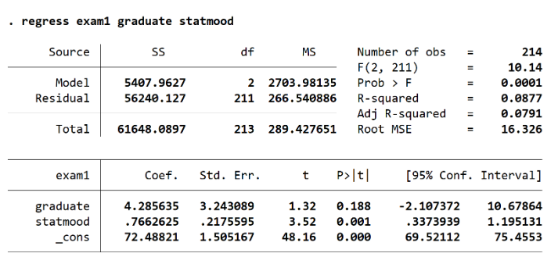

Slide 6
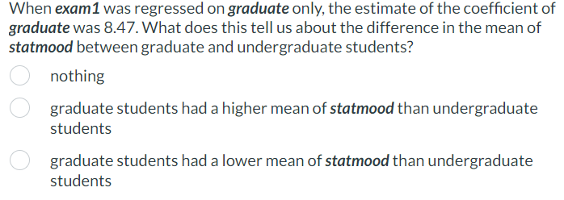

Slide 7
Practice

Slide 8
Load the pisa2000.dta (which you need for HW3 and HW4)
Create a boxplot for wleread, and report its mean, median, and standard deviation
Regress wleread on test_lan for USA only
Report out whether the slope is significant using the notation you’ll use on the project
Give the breakdown of participants per country

Slide 9
Lab 05.do

Slide 10
HW 3 and 4

